Slide 1

ACADEMIC SURVEY
LLM-Based Bloom's Taxonomy Classification Studies
Datasets Used
A Comprehensive Survey of Training and Evaluation Datasets for Automated Educational Content Classification
February 2026
Dataset Analysis

Slide 2
OVERVIEW
Contents
01
Introduction to Bloom's Taxonomy Classification
02
Dataset Overview and Taxonomy
Hierarchical model and LLM-based automation
Scope, distribution, and categorization
03
Large-Scale Private Datasets
04
Public Benchmark Datasets
Learning objectives and exam questions
BloomNet and combined collections
05
Classic Public Datasets
06
Additional Public Resources
Foundational resources and benchmarks
Kaggle datasets and community resources
07
Dataset Comparison and Analysis
08
Key Findings and Implications
Size, type, and availability comparison
Future directions and recommendations

Slide 3
1.1 BACKGROUND
Introduction to Bloom's Taxonomy Classification
Bloom's Taxonomy Framework
Applications in Educational Technology
Bloom's Taxonomy is a hierarchical model that categorizes educational learning objectives into six cognitive levels, ranging from lower-order thinking skills to higher-order thinking skills.
Learning Objective Analysis
Automated evaluation of course learning outcomes
Exam Question Classification
Assessment of cognitive complexity in tests
1
Remember
2
Understand
Curriculum Alignment
3
Apply
4
Analyze
Ensuring balanced cognitive coverage
Quality Assurance
5
Evaluate
6
Create
Systematic evaluation of educational materials
LLM-Based Classification
Large Language Models (LLMs) enable automated classification of educational content according to Bloom's cognitive levels. This automation facilitates large-scale analysis of learning objectives, exam questions, and assessment quality across diverse educational contexts.
Objective: This survey examines the datasets used to train and evaluate LLM-based Bloom's taxonomy classification systems, providing insights into data availability, quality, and accessibility for researchers and practitioners.

Slide 4
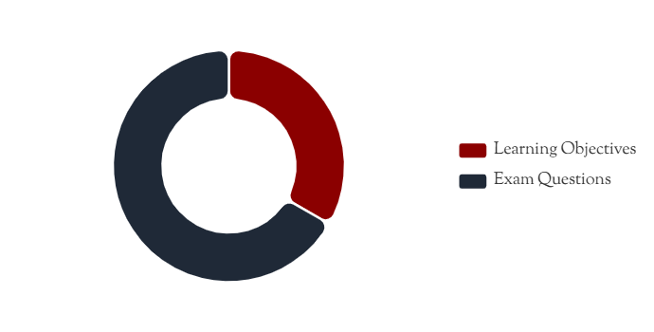
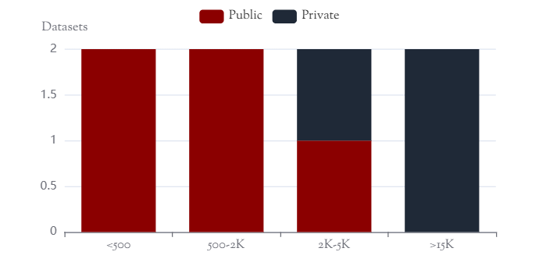
1.2 DATASET LANDSCAPE
Dataset Overview: Scope and Distribution
Total Datasets
Size Range
Availability
9+
141-21K
50%
Major datasets identified in literature
Items per dataset
Publicly accessible
Dataset Type Distribution
Availability by Dataset Size
Learning Objectives: Course-level educational goals describing intended learning outcomes
Exam Questions: Assessment items including essays, short answers, and multiple-choice questions

Slide 5
2.1 PRIVATE DATASETS
Large-Scale Private Datasets (I): Learning Objectives
Li et al. (2022)
LARGEST
Sebbaq & El Faddouli (2022)
MOOC
Dataset Size
Dataset Size
21,380 learning objectives
2,394 learning objectives
Source
Source
5,558 university courses across multiple domains
Various Massive Open Online Courses (MOOCs)
Annotation
Application
Manually labeled with Bloom's six cognitive levels
Used to fine-tune BERT for cognitive-level classification
Status
Status
Private - Institution-specific data scraped from course pages
Private - Created for the study, not published separately
Authors indicated plans to open-source, but no public repository is currently available
Demonstrates effectiveness of BERT on MOOC learning objective classification
Key Challenge: Data Accessibility
Both datasets represent significant contributions to the field but remain inaccessible to the broader research community due to institutional constraints and privacy concerns. This limits reproducibility and comparative analysis across studies.

Slide 6
2.2 PRIVATE DATASETS
Large-Scale Private Datasets (II): Exam Questions
Banujan et al. (2023)
16,584
Sri Lanka Exam Questions Dataset
exam questions
Source
Question Types
Taxonomy Version
Multiple Sri Lankan universities
Essays, short answers, MCQs
Revised Bloom's Taxonomy
Annotation
Models Compared
Manually labeled by domain experts across various subjects
ANN, LSTM with GloVe/BERT embeddings
Research Contribution
Availability Status
This study provides a comprehensive comparison of deep learning approaches for Bloom's level classification, demonstrating the effectiveness of transformer-based models (BERT) over traditional neural network architectures.
Private - Dataset described in the paper but not publicly posted. Likely available upon request from authors, subject to institutional approval and data sharing agreements.
Significance: One of the largest exam question datasets for Bloom's taxonomy research, providing valuable insights into assessment practices across multiple Sri Lankan higher education institutions.

Slide 7
3.1 PUBLIC DATASETS
Public Benchmark Datasets: BloomNet and Combined Collections
Waheed et al. (2021)
BLOOMNET
Gani & Sangodiah (figshare)
COMBINED
BloomNet Question Set - Combined two established question datasets for transformer-based classification
Exam Question Datasets - Compiled multiple Bloom-labeled question banks into a unified benchmark
Yahya et al. (2012)
600
Total Questions
~2,500
Open-ended exam questions (100 per Bloom level)
Balanced distribution across Bloom's categories
Haris & Omar (2015)
141
Includes Yahya (600) and Haris (141) datasets
Open-ended questions from diverse sources
Additional questions from various sources
Public - Available via PLOS One Supporting Information
Public - Figshare: DOI 10.6084/m9.figshare.22597957
Balanced Distribution
Research Validated
Open Access
Even representation across all cognitive levels
Used in peer-reviewed publications
Freely available for research use
Impact: These public benchmarks have become foundational resources for the research community, enabling reproducible model development and comparative evaluation across different approaches.

Slide 8
3.2 PUBLIC DATASETS
Classic Public Datasets: Foundational Resources
600
Yahya et al. (2012)
141
Haris & Omar (2015)
Widely-cited benchmark dataset
Complementary question corpus
Dataset Characteristics
Dataset Characteristics
600 short-answer questions evenly distributed across six cognitive levels (100 per level)
141 open-ended examination questions labeled by Bloom's cognitive levels
Subject Coverage
Source Diversity
Sciences, mathematics, technology, and other domains - general benchmark for question classification
Gathered from diverse online sources and prior educational studies
License & Access
License & Access
CC-BY license via PLOS One supplemental files (S1 File)
Public domain via PLOS One (Supporting Information S2 File)
Often used in combination with Yahya et al. dataset for expanded training data
One of the most referenced datasets in Bloom's taxonomy classification literature
Historical Significance and Impact
1
Early Benchmark
2
Validation Standard
3
Open Science
Pioneered systematic Bloom's taxonomy dataset creation for ML research
Became standard evaluation set for comparing classification approaches
Demonstrated value of publicly sharing educational datasets
Key Insight: These foundational datasets established best practices for dataset creation, annotation, and sharing in the educational data mining community, influencing subsequent research for over a decade.

Slide 9
3.3 PUBLIC RESOURCES
Additional Public Resources and Community Datasets
Kaggle Dataset
Quick Flip Questions
Research Corpora
Devane (2023)
Revised Bloom's Taxonomy
Domain-Specific Studies
Bloom's Taxonomy Dataset for educational analysis
Reference dataset of prototypical question stems
Various studies with limited data sharing
Single CSV file with exam questions and annotations
Question prompts categorized by cognitive level
Harrison et al. (2019): ~1,500 items
Computer science and other domains
From Edupress Quick Flip (EP-729)
Huang et al. (2021): K-12 classroom questions
Public - Kaggle platform
Public domain - Widely shared by educators
Programming exam questions (various)
Requires Kaggle login for download
Pedagogical resource for question design
Most not openly available
Community Dataset Ecosystem
Available Resources
Limitations
Kaggle provides accessible platform for dataset sharing
Many domain-specific datasets remain unpublished
Quick Flip Questions serve as pedagogical reference
Small-scale studies lack resources for data sharing
Figshare and PLOS One enable academic data publication
No centralized repository for Bloom's taxonomy datasets
Community Need: While individual researchers continue to produce labeled datasets, the field would benefit from a centralized, community-curated repository to consolidate resources and promote reproducible research.

Slide 10
4.1 COMPARATIVE ANALYSIS
Dataset Comparison: Size, Type, and Availability
Dataset | Size | Type | Taxonomy | Status
Li et al. (2022) | 21,380 | Learning Objectives | Original (6 levels) | PRIVATE
Banujan et al. (2023) | 16,584 | Exam Questions | Revised | PRIVATE
Gani & Sangodiah (2024) | ~2,500 | Exam Questions | Original (6 levels) | PUBLIC
Sebbaq & El Faddouli (2022) | 2,394 | Learning Objectives | Original (6 levels) | PRIVATE
Yahya et al. (2012) | 600 | Exam Questions | Original (6 levels) | PUBLIC
Waheed et al. (2021) | 741 | Exam Questions | Original (6 levels) | PUBLIC
Haris & Omar (2015) | 141 | Exam Questions | Original (6 levels) | PUBLIC
Devane (2023) - Kaggle | Varies | Exam Questions | Mixed | PUBLIC
Size Distribution
Content Type
Availability
Large (>10K)
2 datasets
Learning Objectives
2 datasets
Public
5 datasets
Medium (1K-10K)
2 datasets
Exam Questions
6+ datasets
Private
3 datasets
Small (<1K)
4+ datasets
Mixed/Other
1 dataset
Public %
~62.5%

Slide 11
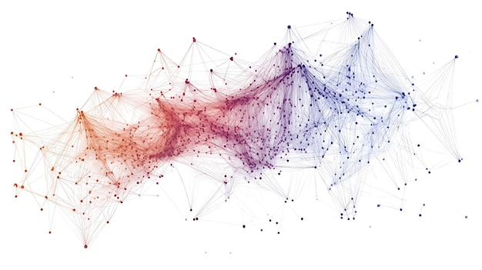
CONCLUSIONS
Key Findings and Future Directions
Key Findings
Future Directions
1
Diverse Ecosystem: Nine+ major datasets support LLM-based Bloom's taxonomy classification, spanning learning objectives and exam questions
1
Data Sharing: Develop protocols and incentives for institutional dataset sharing
2
Size Variation: Datasets range from 141 to 21,380 items, with larger datasets predominantly remaining private
2
Centralized Repository: Create community-curated dataset hub for consolidated access
3
Public Foundations: Classic datasets (Yahya, Haris & Omar) provide solid benchmarks for model development
3
Standardization: Establish common annotation guidelines and evaluation protocols
4
Accessibility Gap: 60% of total dataset items remain inaccessible due to institutional constraints
4
Large-Scale Public Sets: Create new large, diverse, openly accessible datasets
Research Impact and Implications
This survey reveals that while the field has made significant progress in automated Bloom's taxonomy classification, realizing the full potential of LLM-based approaches requires addressing data accessibility challenges. By fostering a culture of open science and collaborative dataset development, the research community can accelerate innovation and improve educational assessment practices worldwide.
9+ Datasets Surveyed
2012-2024 Coverage
Survey completed February 2026

